Slide 1
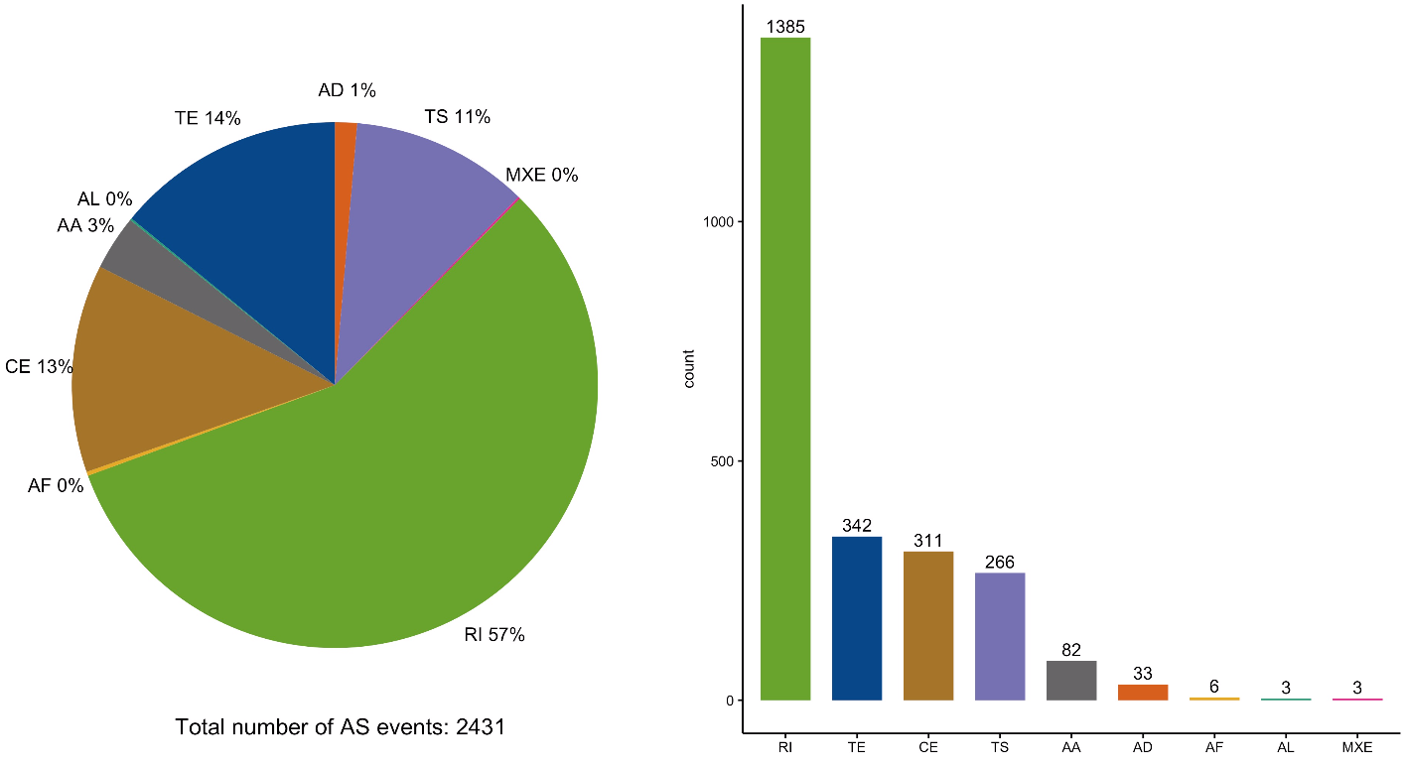
FASTQ files (raw reads)
QC
Trimming
Whippet
IRfinder
rMATS
Build ref index
Alignment
Build ref index
Alignment
Build ref index
Alignment
PSI results for each sample
Pool and contrast PSI
14 VS CTRL & 89 VS CTRL
Filter:
absDeltaPSI > 0.1
Probability > 0.9
PSI_KD > 0.1
Filter: remove known exon and minor isoform
FDR < 0.05
Filter:
FDR < 0.05
Significant events: intersection
Combine
Remove duplicates
PSI_KD = (PSI_14 + PSI_89)/2
deltaPSI = PSI_KD – PSI_CTRL
Add gene name
Final table

Slide 2
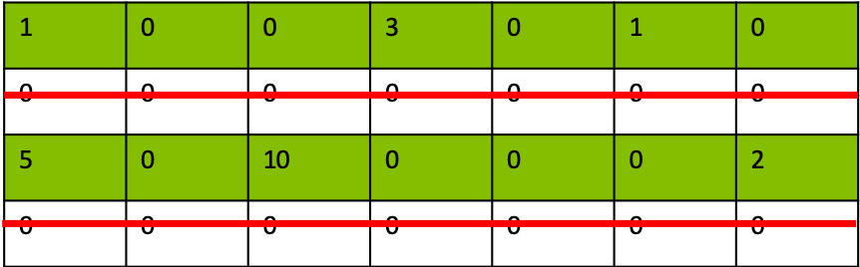
All the genes
in the annotation file
Select the genes that have expression in ≥ 1 sample(s)
Get the set of unique introns
from all the transcripts
of each gene
Transcript a:
e.g.
Gene X
Transcript b:
Transcript c:
Transcript d:
Transcript e:
Keep the introns
with length > 30
Total number: 335,436

Slide 3
IRfinder
siSDE2-1 VS control
IRfinder
siSDE2-2 VS control
GENCODE V27
gene annotation
Remove known exon and minor isoform
Remove known exon and minor isoform
Extract all constitutive introns
FDR < 0.05
FDR < 0.05
Remove Sig and Non-sig ones from siSDE2
YES
NO
YES
NO
Sig
events
Non-sig
events
Sig
events
Non-sig
events
length < 75th percentile of Sig events
YES
NO
Intersected
Sig events
Intersected
Non-sig events
Non-AS-short
events
Non-AS-long
events
Notes:
Fig 3

Slide 4
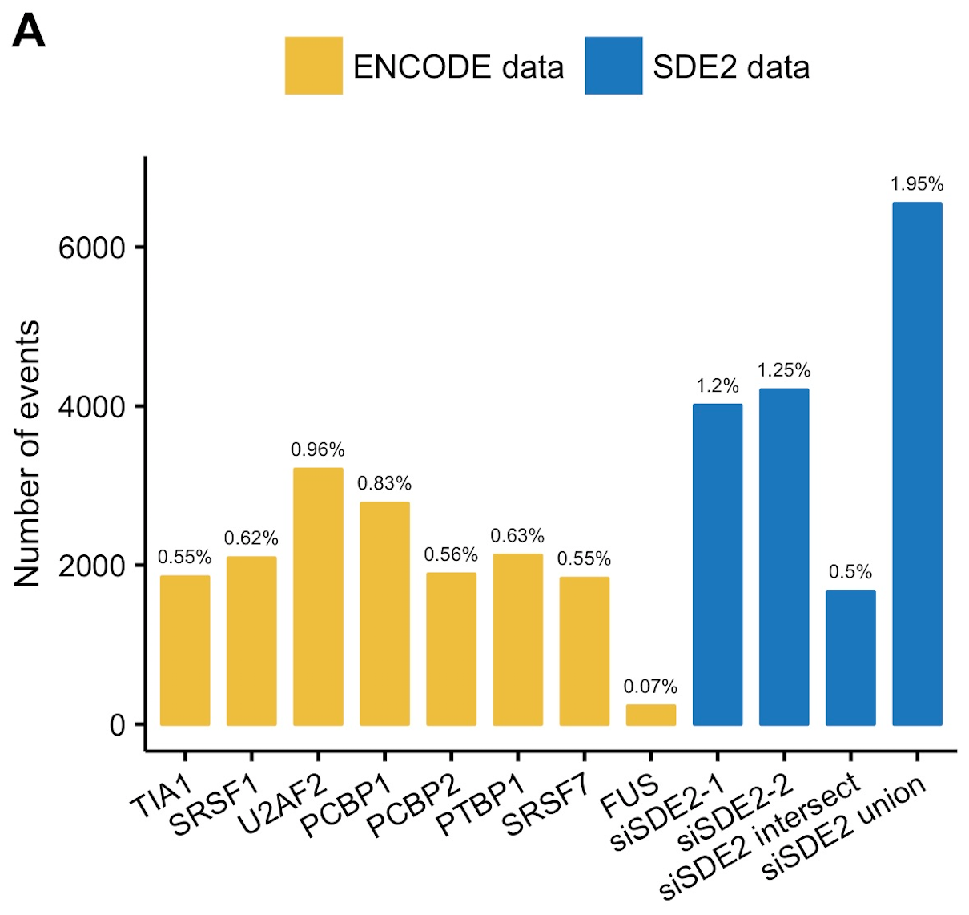
ENCODE data
SDE2 data
shTIA1 VS control
shSRSF1 VS control
shU2AF2 VS control
shPCBP1 VS control
shPCBP2 VS control
shPTBP1 VS control
shSRSF7 VS control
shFUS VS control
siSDE2-1 VS control
siSDE2-2 VS control
Intersect of the two
Union of the two
Filter
Filter
P < 0.05
P < 0.05
Filter
Filter
KD_IRratio > CTRL_IRratio
for increased
IR events in KD
KD_IRratio > CTRL_IRratio
for increased
IR events in KD
Divide by the total number of introns in the genome
Divide by the total number of introns in the genome
Percentages
Percentages

Slide 5
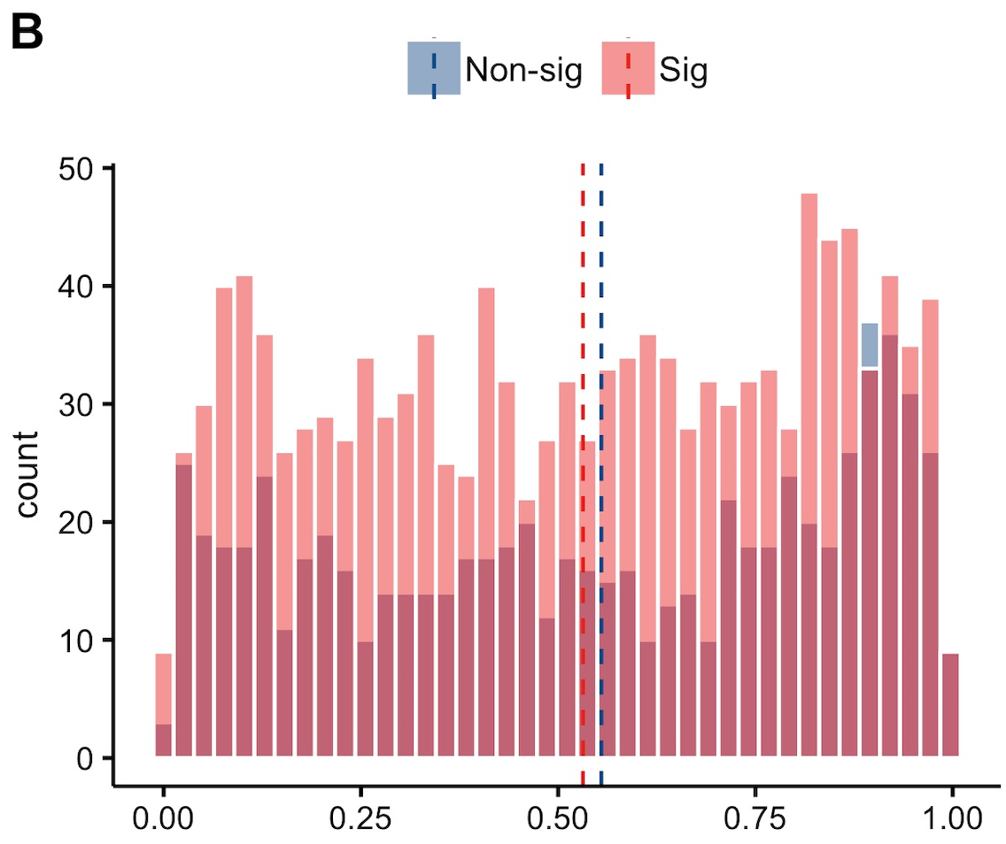
Sig IR events
Non-sig IR events
Get the middle point of the locus
Get the middle point of the locus
Get that gene’s start and end coord
Get that gene’s start and end coord
Normalized gene body position
=
IR middle point – gene start coord
gene end coord – gene start coord

Slide 6
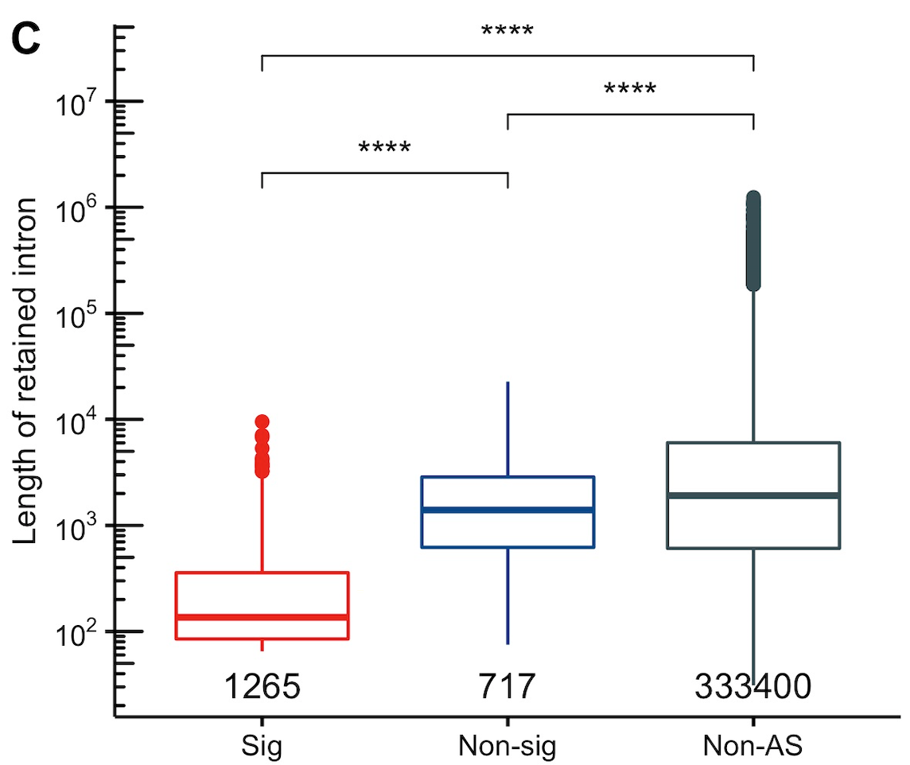
Sig IR events
Non-sig IR events
Non-AS
All the introns in the genome except the Sig and Non-sig ones
Len = end – start
Len = end – start
Len = end – start

Slide 7
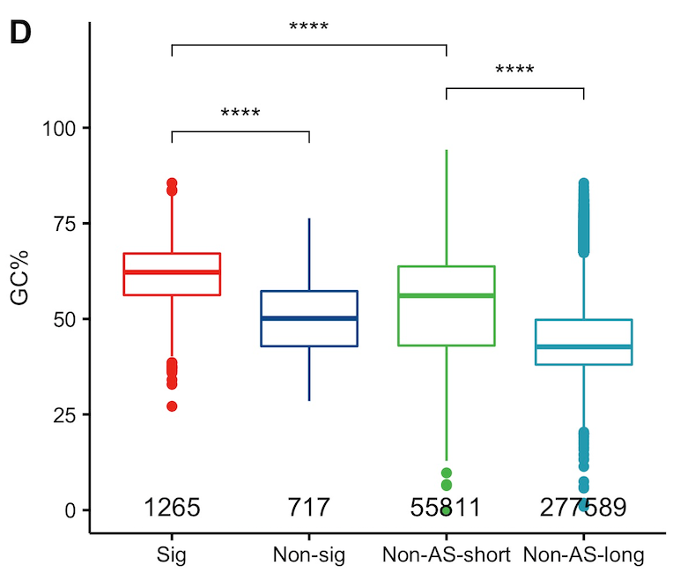
Sig IR events
Non-sig IR events
Non-AS-short
events
Non-AS-long
events
GC% =
#G + #C
IR event length

Slide 8
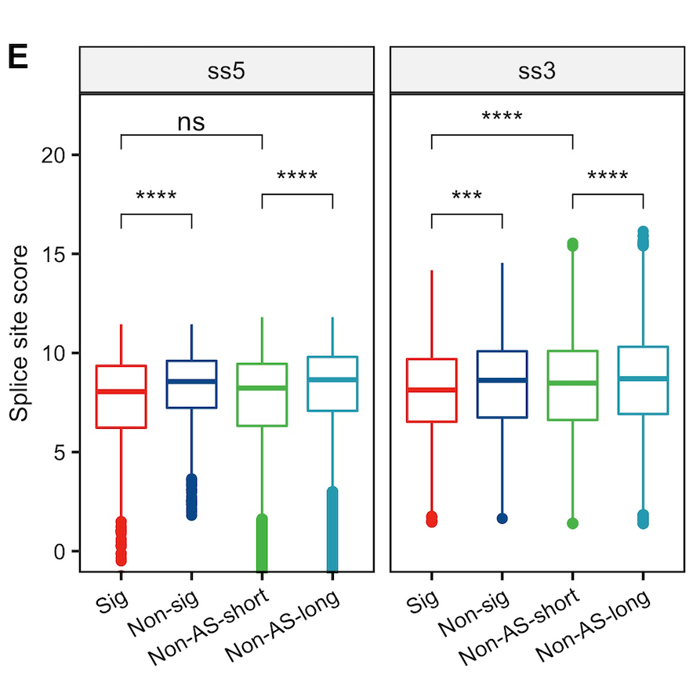
Sig IR events
Non-sig IR events
Non-AS-short
events
Non-AS-long
events
5’ end seq
3’ end seq
3 bases
6 bases
20 bases
3 bases
Exon
Intron
Intron
Exon
MaxEntScan
MaxEntScan
≥ 50% of the seq should have the correct signal at the position
(e.g. GT at 5’ and AG at 3’)
Filtering:
Score ≥ -7.2
Filtering:
Score ≥ 1.4

Slide 9


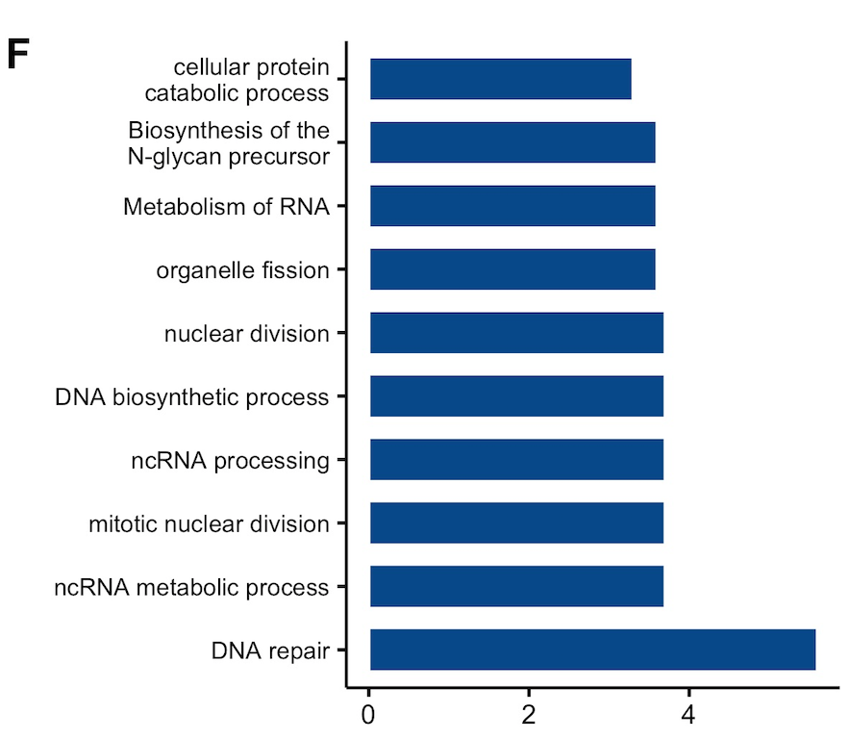
Sig IR events
unique Ensembl Gene IDs
Geneset enrichment analysis
Sort by –log₁₀(FDR)
Top 10 terms

